Slide 1
Introduction to Big Datalake Storage <-> Big Cluster Compute Sample Usages in Companies
arnaud.nauwynck@gmail.com
Course 2024
@Copyright All rights reserved
this document: https://github.com/Arnaud-Nauwynck/Presentations/big-data/ 0-Introduction-Big-Datalake-Storage-Big-cluster-Compute

Slide 2
Objectives
4 x 1h30 of lessons
4 x 3h of Hands-On
Objective Lesson 1 : Overview
What is BigData ?
What is Spark ?
What is Data processing ?
… concrete examples from experience in a company
Objective Lesson 2,3,4 : Deep Dive in Spark

Slide 3
Outline
What is BigData ?
Order of Magnitudes for « Big »
Distributed System challenges
Scaling Storage Resources: Hdfs
Scaling Compute Resources: Yarn, Kubernetes
Using Storage – Compute apis
Evolution of Hardware – Softwares – Hadoop Ecosystem, Spark
Description of a Datalake
Content
Usages
Example of Data-Processing
RAW to LAKE, Reports
Evolution to Cloud

Slide 4
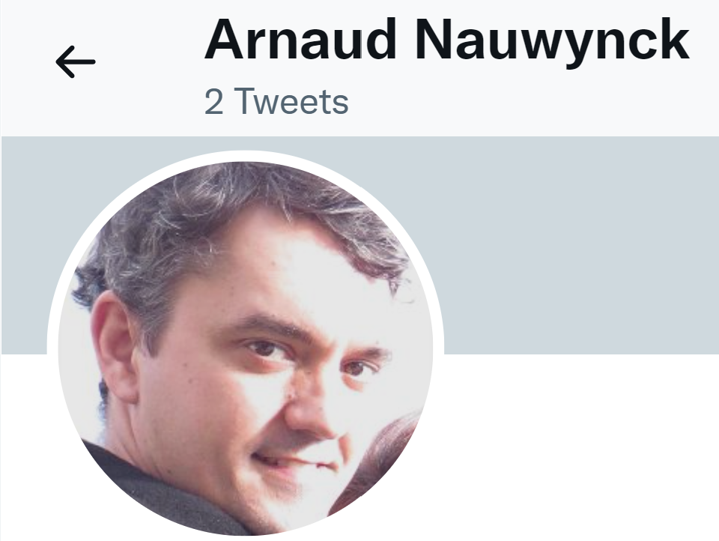
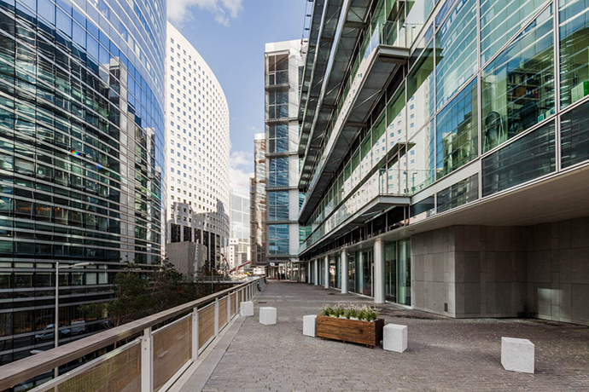
About Me
NOT using Twitter/LinkedIn/FaceBook/
Only
arnaud.nauwynck@gmail.com
IT Passionate since 26 years
Working at Société Générale (La Defense)
In BigData team since 6 years
Expert Java + BigData + more
Github repos
https://github.com/Arnaud-Nauwynck
http://arnaud-nauwynck.github.io/

Slide 5
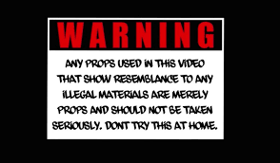
DISCLAIMER I do not know everything. I am biaised with what I know. My opinions do not represent any company

Slide 6
About You … Quick Survey ?
Raise your Hands…
You are developper ?
In Java ? SQL ?
You know Hadoop / Hdfs / Spark ?
You want to be Data Engineer / Data Scientist ?

Slide 7
Outline
What is BigData ?
Order of Magnitudes for « Big »
Distributed System challenges
Scaling Storage Resources: Hdfs
Scaling Compute Resources: Yarn, Kubernetes
Using Storage – Compute apis
Evolution of Hardware – Softwares – Hadoop Ecosystem, Spark
Description of a Datalake
Content
Usages
Example of Data-Processing
RAW to LAKE, Reports
Evolution to Cloud

Slide 8
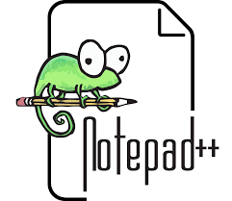






How Big ? => Then Which Tool
1 .. 1 000
50 000
1 Million (e6)
( Mega Bytes)
1 Billion(e9)
( Tera Bytes)
>= e9 : BIG Data
( Peta Bytes)

Slide 9
Compute Resources Vertical Scaling
Historically: have Bigger needs => buy BIGGER Server
Very Frequent in Bank OLTP Databases
128 cores x 500Go RAM + SAN Bay of Disks
= Millions of Euros
.. BUT price is exponential to performance, and limited

Slide 10
BigData definition
Data does not fit on 1 server … even Huge, because of
3 V = Volume / Velocity / Variety

Slide 11
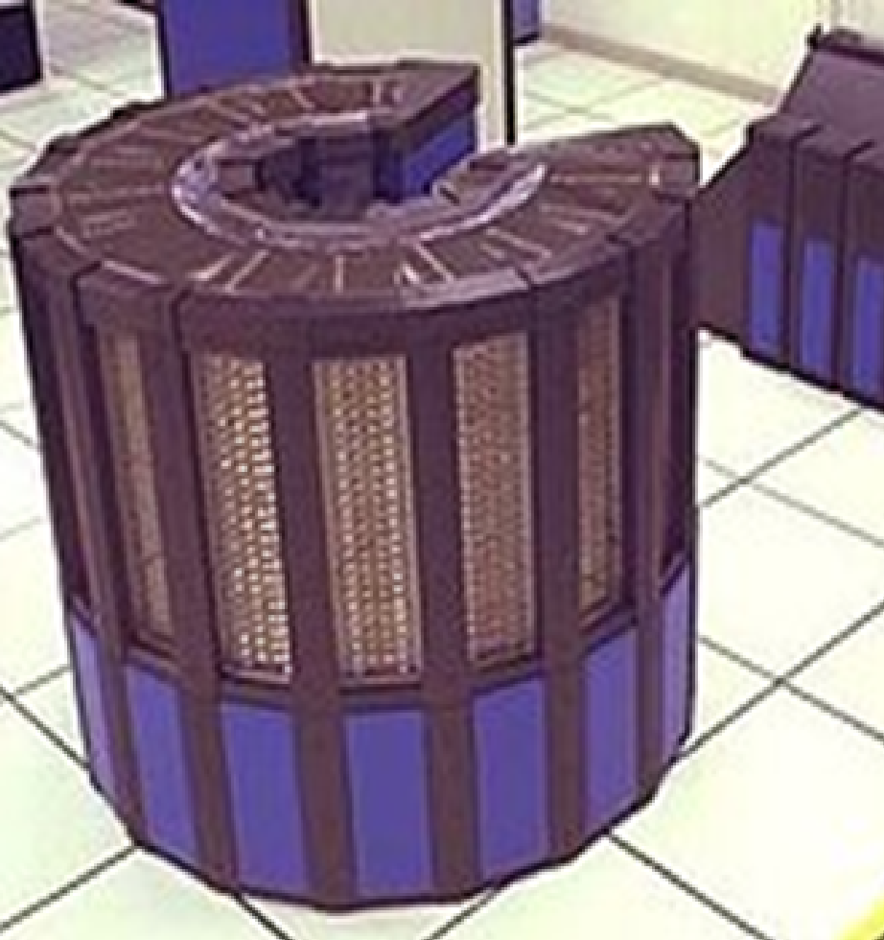
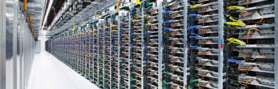
Bigger Hardware, different Software
Vertical Scaling -> Horyzontal
1 OS, 1 process, N Threads
Distributed computing
… Sotfwares need
Network, Fault Tolerant

Slide 12

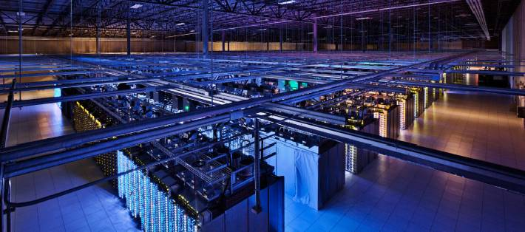
BigData At Scale Google Datacenter

Slide 13
Not Only Gafas
Example of Smaller Companies, obviously doing BigData
Criteo (internet advertisment)
Cern (particule accelerators)
Gouvernment
Social Networks
Auchan, Carrefour, .. (E-Commerce)
MeteoFrance ( Computing, Satelite Images)
Uber, Taxis, Cars ( IOT )
Medical, Pharmaceutic, Genetics
Industries
Banks
..

Slide 14
BigData In Banks ?
Corporate Investment Bank
Network Bank (for everybody customers)
(for private / owned trading )
Example of Société Genérale:
At La Defense
Example of Société Genérale:
At Val de Fontenay
Data for
Historical Market datas
Risk / Var management
Aggregation of all Trading departments
Regulatory Reporting
Business analysis
..
Data for
RGPD… warn personnal data!
Anti Fraud detection,
customers-oriented
Business analysis
..

Slide 15
BigData at SG (Investment Bank)
PROD Cluster
>= 3 Petas of Data
( 9 petas of Disks,
with replicationFactor=3)
+ DEV Cluster
.. Containing backups of PROD Data
+ others
Clusters

Slide 16
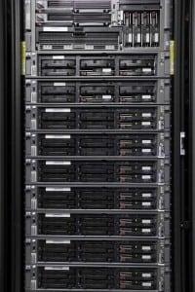
Typical Datacenter Hardware = N Racks x 10 blades (1U / 2U)

Slide 17

1U Server for Datalake
1 server = 42 cores + 256 Go RAM + network 1Gb/s + 8 disks
« Compute » Resources
« Storage » Resources

Slide 18

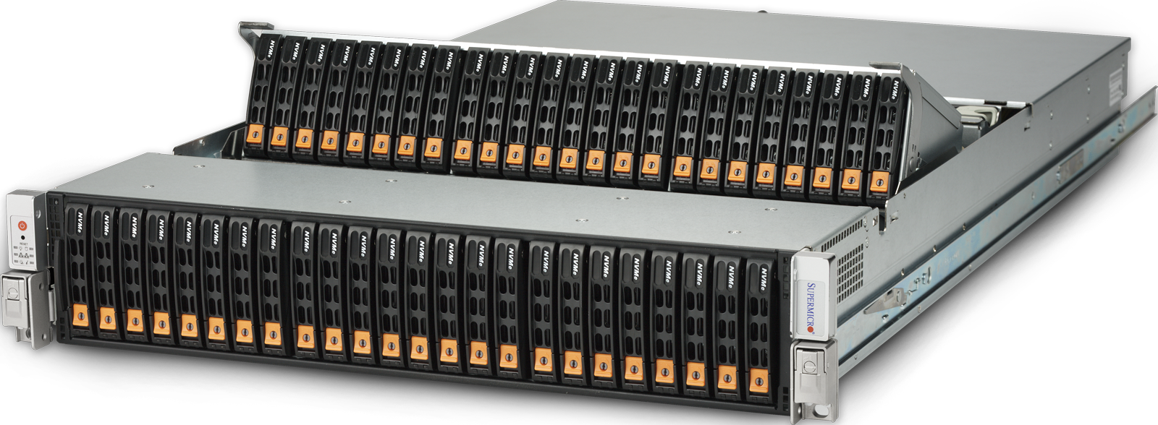
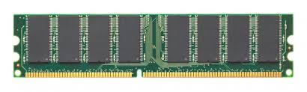

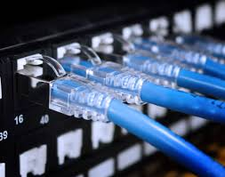
Trend.. Splitting Compute and Storage Resources Virtualizing (VMs,Kubernetes,Cloud) for Elasticity & Costs
For Hardware historical performance
Compute = linked to Storage
1 Fixed « Compute » + local « Storage » Resource
Compute ONLY Virtual Resource
Storage ONLY Virtual Resource
Provision on-demand Cluster, VMs in cluster
Choose RAM (compromise perf/cost) per VM
Dedicated for app workloads
Elastic storage, pay as-you-go
Dedicated hardwares for data density

Slide 19
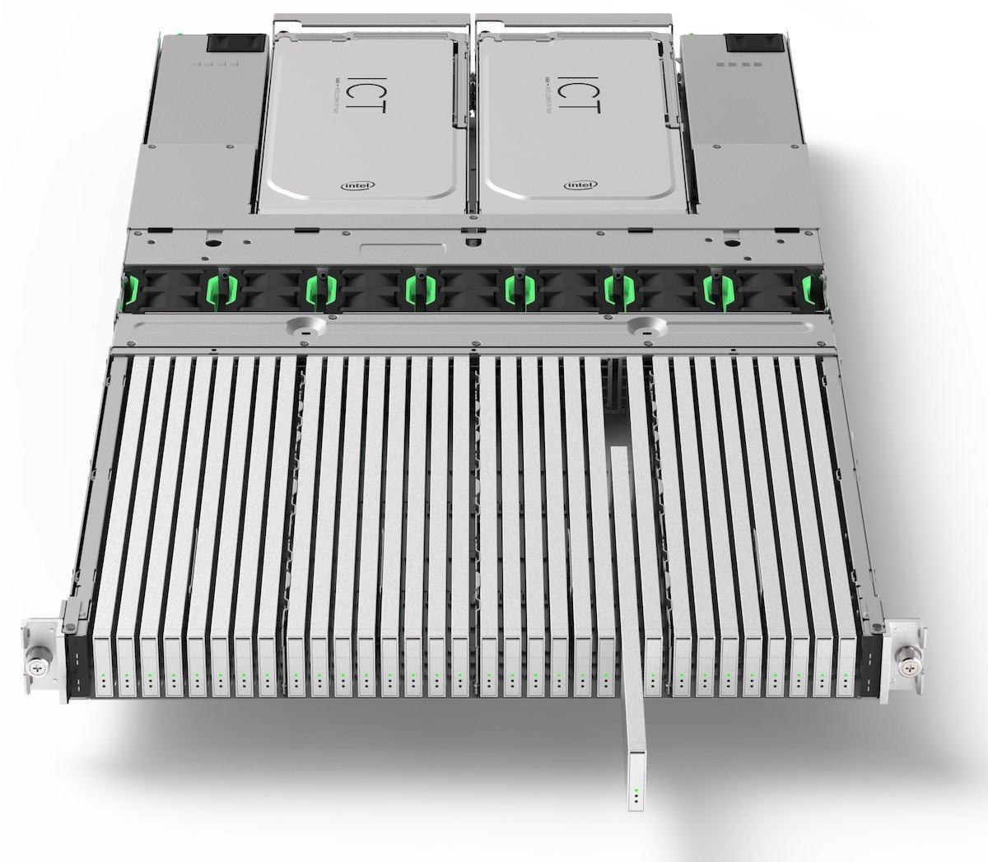
Data Density
48 * HDD disks in 2U blade
32 * SSD (E.1 EDSFF) in 1U blade
… 500 Tera / 1 Peta !! … 200 000 euros

Slide 20
On-Premise « Small » Datalake ?
100 servers for PROD
( + 120 servers for DEV )
= 4200 cores
+ 25600 Go RAM : 25 Tera of RAMS
+ 800 disks : 2 Petas of Data ( 6 peta of Disks )
… now 3 Petas on Azure

Slide 21


Hadoop Cluster Architecture
Firewall
2 Main HeadNode Server
(NameNode, Oozie, Yarn..)
Allow Https Hadoop APIs
(Knox, Oozie, Yarn,
Hdfs, Hive Hue, Ambari..)
LoadBalancer
100 DataNodes
Allow SSH
On « Edge » Node for command line oozie, yarn, Spark, ..
Postgresql for
Oozie,Yarn,Ranger, Hive Metastore..
$ _
8 Kafka Brokers
For streaming
Kafka, Jms, tibcoEMS
Flume + http front
Installed Hadoop Distribution
http for ADMIN (Internal APIs)

Slide 22
Outline
What is BigData ?
Order of Magnitudes for « Big »
Distributed System challenges
Scaling Storage Resources: Hdfs
Scaling Compute Resources: Yarn, Kubernetes
Using Storage – Compute apis
Evolution of Hardware – Softwares – Hadoop Ecosystem, Spark
Description of a Datalake
Content
Usages
Example of Data-Processing
RAW to LAKE, Reports
Evolution to Cloud

Slide 23
Handling 1 Server + 1 Disk … OK with SSH,Bash,Java... How to handle 300 Servers ? 1 Billions Files ? In 50 Millions Directories ? … At Scale (performance, and way of working in IT teams)

Slide 24
Challenge #1: Unify « Virtual » Storage Resources
IO Read+Write API
Physical « Storage » Resources
= 800 HDD Disks (on 100 Linux servers + network)
1 Virtual (Abstract) « Storage » Resource
= HDFS Hadoop Distributed File System

Slide 25
Mind Shift .. Datalake FileSystem Abstractions
Instead of
Handling remote SSH / SCP
and naming server & dirs …
Do this:
Servers are invisible to users
User see virtual HDFS Dirs & Files
# SSH for Remote command
$ ssh server-abc-for-dept-xyz
$ cd someDir
$ mkdir .. Ls … cp … launch java
$ scp result.file another-server:
# SCP for Remote Copy to Local
$ scp server-abc-for-dept-xyz:result.file local.file
# execute commands from any client
$ hdfs dfs –ls /datalake/a/b
$ hdfs dfs mkdir /datalake/a/b/c
$ hdfs dfs rm /datalake/a/b/d
# Upload local file to Remote
$ hdfs dfs put ./local.file /datalake/a/file
# Download Remote File to local
$ hdfs dfs get /datalake/a/file ./local.file

Slide 26
Challenges of Distributed System
How to Handle ?
Failures,
Resilience,
Horyzontal Scalling,
Availability,
Consistance,
Replication,
…

Slide 27

Sh*ts Happens (Hardware Failures, Software, Electric Power, Network, Data Corruption ..)
Example for 1 Disk
MTBF = Mean Time Between Failure = ~25 years
… FINE ! …. Wait ! Fine ????
for a big cluster 20 000 servers x 8 Disks => ??

Slide 28
Big Data = Handle « Normal » (recurrent) Failures !
1 Disk: 25 Y = 25*365*24 hours = 219k hours … 1 Cluster: 20000*8=160k
=> In average : 1 failure every 1h30mn … 17 per days !!
Failure is NOT exceptional, it is the « normal » way
System must (try to) handle it TRANSPARENTLY

Slide 29
Outline
What is BigData ?
Order of Magnitudes for « Big »
Distributed System challenges
Scaling Storage Resources: Hdfs
Scaling Compute Resources: Yarn, Kubernetes
Using Storage – Compute apis
Evolution of Hardware – Softwares – Hadoop Ecosystem, Spark
Description of a Datalake
Content
Usages
Example of Data-Processing
RAW to LAKE, Reports
Evolution to Cloud

Slide 30
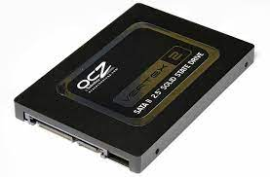
How to Handle Disk Crash: Obviously Replication Copies, But in XA & Real-Time
RF = Replication Factor = 3 (or more!)
End-user operation =
Write to a « virtual File »
Sharding:
Choosing
group of 3 disks
out of 20000
Then Dispatch to
the current « Master »
Server for this group
Then Immediate COPY
… hopefully Transactionally
To current « follower » servers

Slide 31
The Devil hides in the Details …
the « master » server can not reach other for copying ? Or takes too long
Files will become « Under-replicated », after a server crash (or switch Off)
… « Over-replicated » when the server rejoin cluster (switch ON)
2 servers pretend to be « master » at same time (network partition) ?
Reconcile 2 conflicting (diverged) servers data ?
SPOF : Single Point Of Failures … all servers depends of same Electric Power supply
Etc, Etc, Etc ...

Slide 32
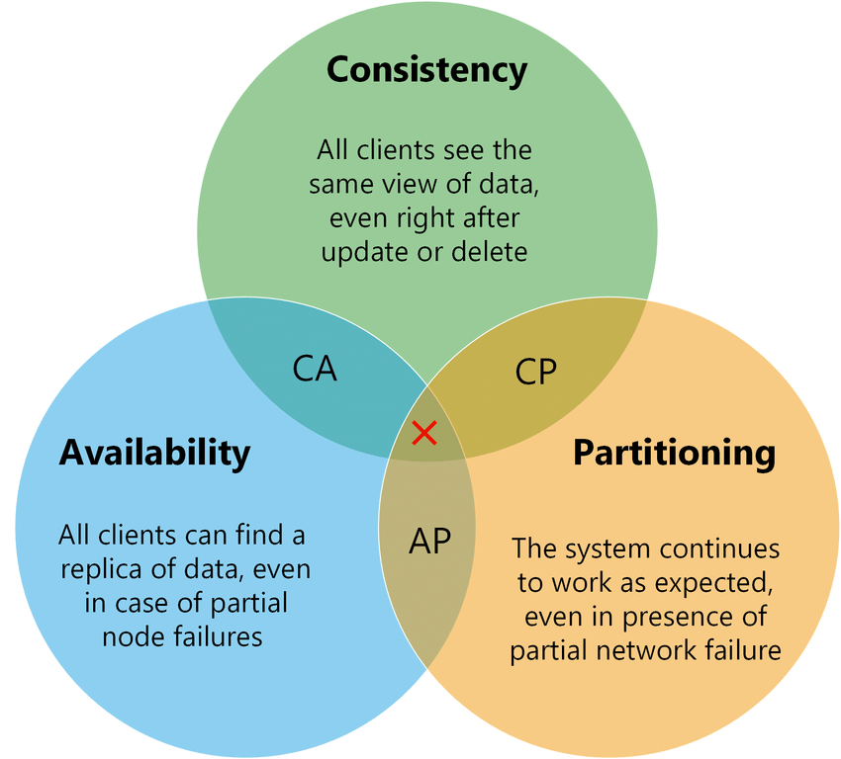
CAP Theorem .. Choose 2 out of 3

Slide 33
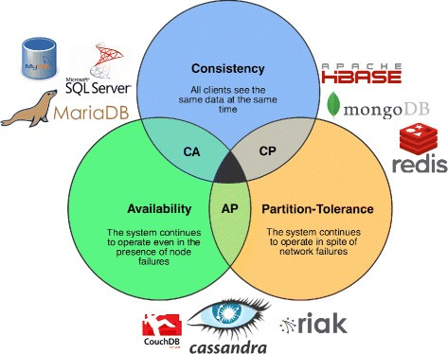
Databases choices
« Eventually Consistent »
.. Means « NOT » always consistent … but ends to be

Slide 34

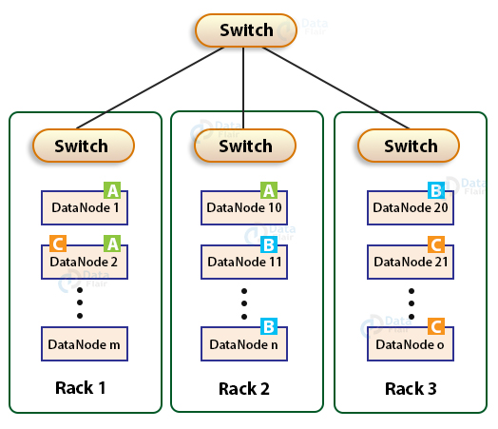
Hadoop Legacy Replication Factor: Rack Aware
East-West traffic
(relatively slow / limited)
Top-Rack switch
North-South traffic (fast)
Allow replicate 1
in same Rack
(fast)
Then must replicate >= 1
in other Rack
replicate more.. In other HDFS datacenter (distcp)

Slide 35
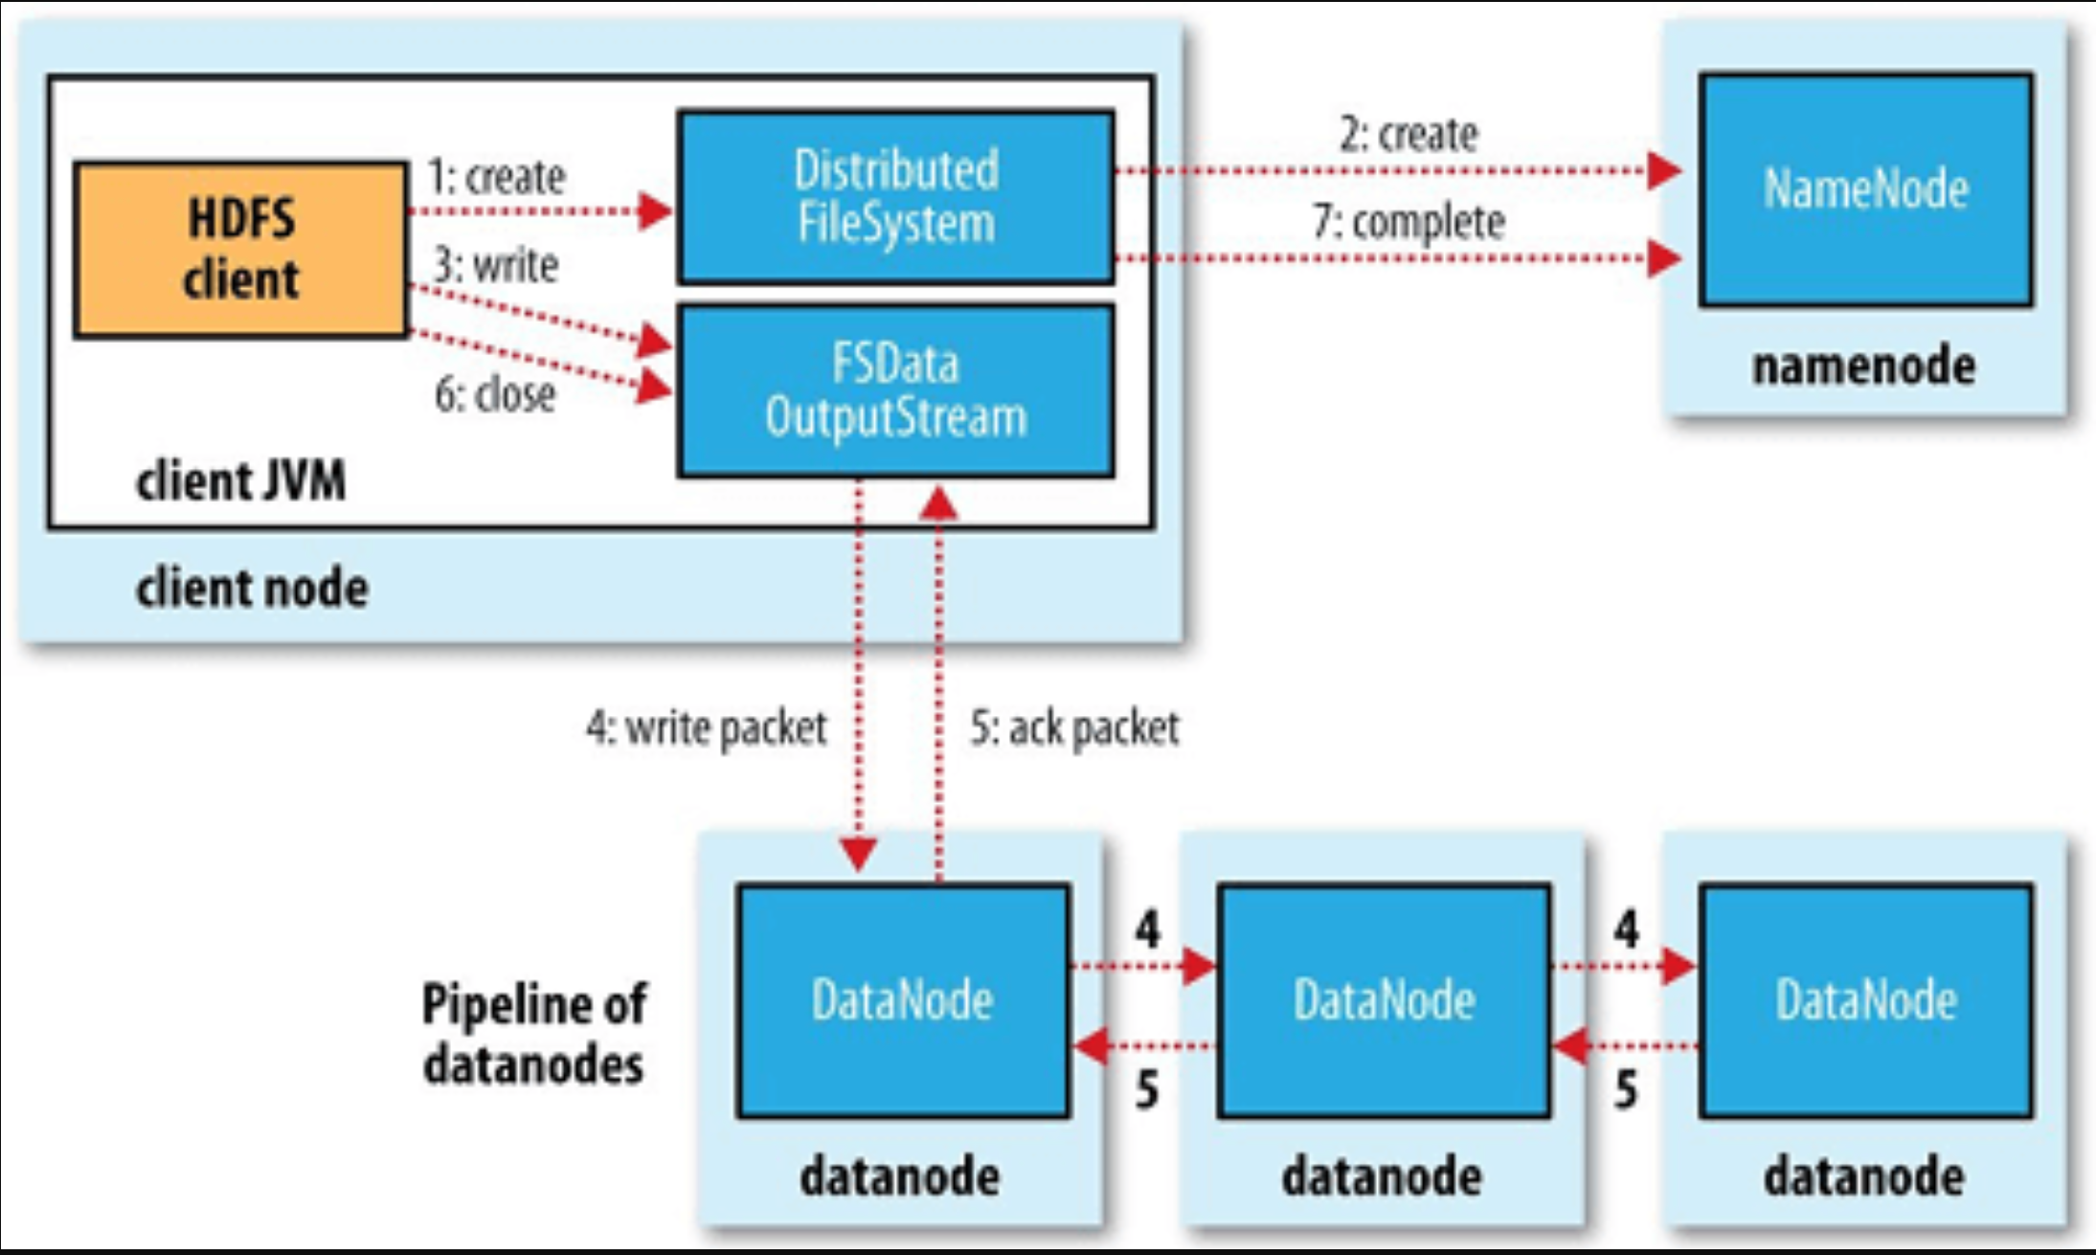
Writing a HDFS File

Slide 36
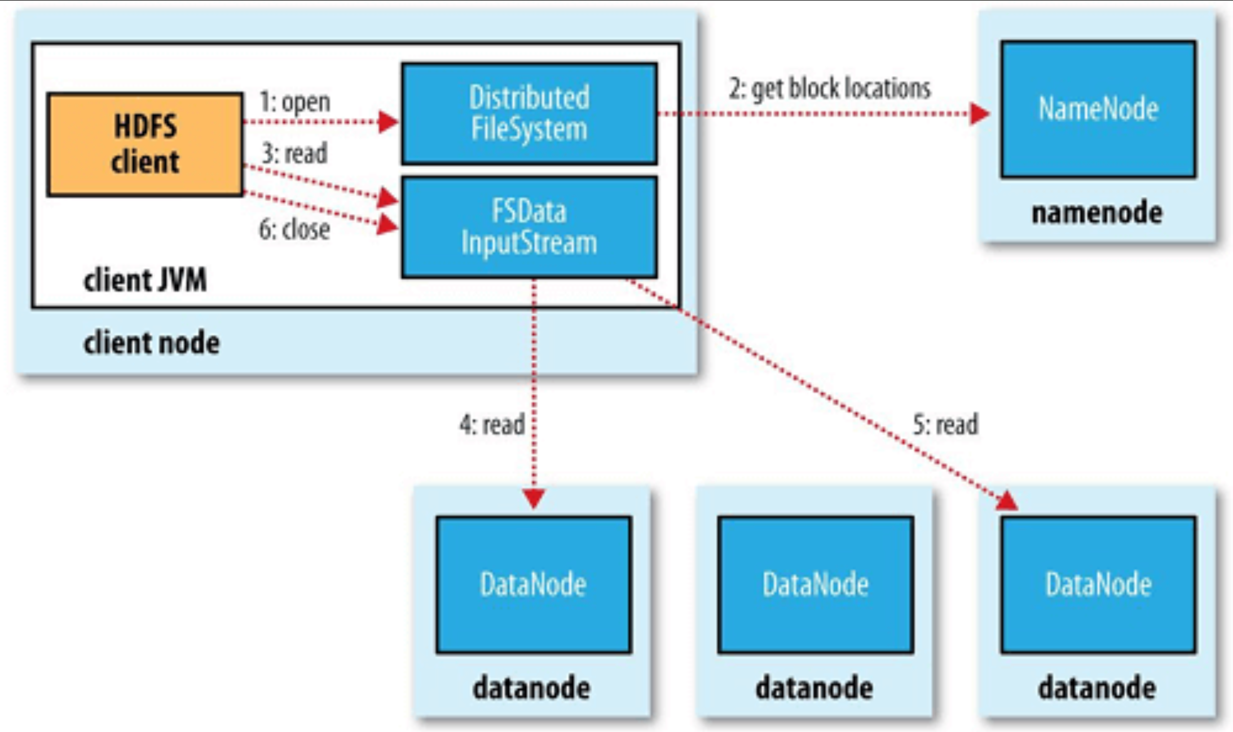
Reading a HDFS File

Slide 37
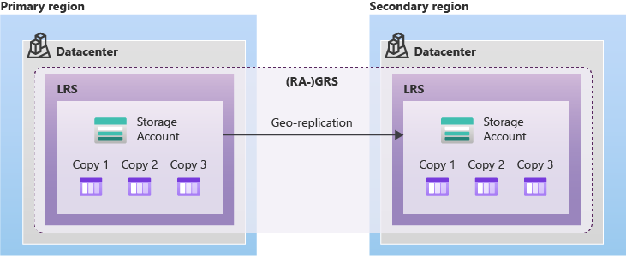
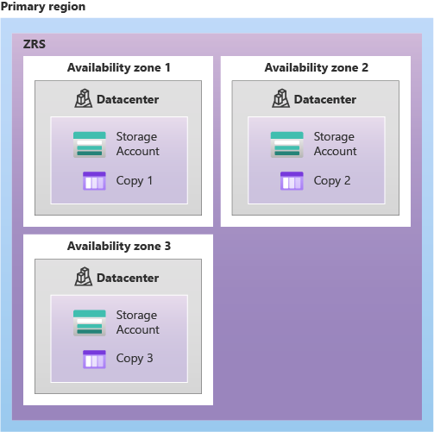
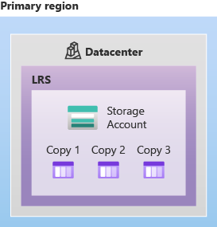
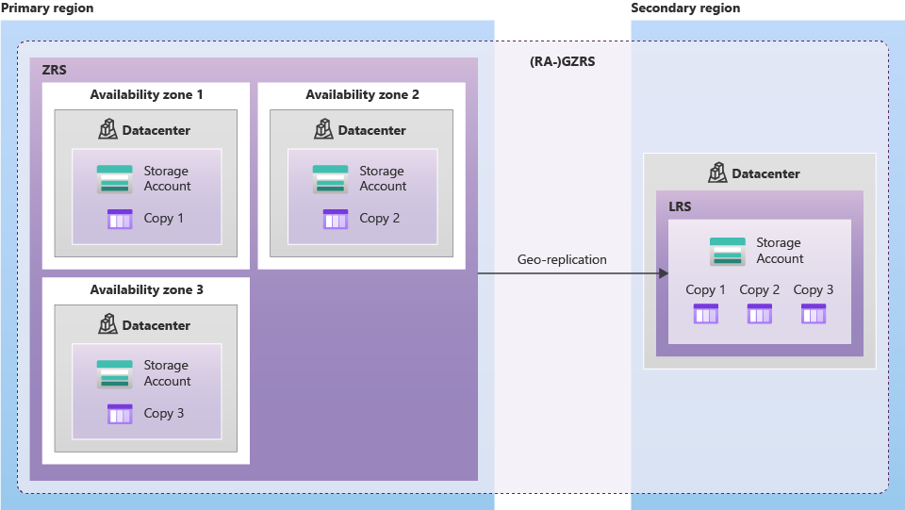
Example on Azure Storage… LRS, ZRS, GRS, GZRS 1 Region = 3 AZ (Availability Zone) .. 3 Datacenters
(RA-) GRS … 1 LRS + async 1LRS, 2 zones
LRS (cheaper)
… 1 Datacenter
ZRS … 1 Region
(RA-) GZRS … 1 ZRS + async 1LRS

Slide 38
Recap … Storage Resources
Coffe Break ?

Slide 39
Outline
What is BigData ?
Order of Magnitudes for « Big »
Distributed System challenges
Scaling Storage Resources: Hdfs
Scaling Compute Resources: Yarn, Kubernetes
Using Storage – Compute apis
Evolution of Hardware – Softwares – Hadoop Ecosystem, Spark
Description of a Datalake
Content
Usages
Example of Data-Processing
RAW to LAKE, Reports
Evolution to Cloud

Slide 40
Reminder … Hadoop Cluster Architecture
Firewall
2 Main HeadNode Server
(NameNode, Oozie, Yarn..)
Allow Https Hadoop APIs
(Knox, Oozie, Yarn,
Hdfs, Hive Hue, Ambari..)
LoadBalancer
100 DataNodes
Allow SSH
On « Edge » Node for command line oozie, yarn, Spark, ..
Postgresql for
Oozie,Yarn,Ranger, Hive Metastore..
$ _
8 Kafka Brokers
For streaming
Kafka, Jms, tibcoEMS
Flume + http front
Installed Hadoop Distribution
http for ADMIN (Internal APIs)

Slide 41
2 Distributed Challenges : 1=Storage + 1=Compute
Job
Start/Stop/..
/Connect
API
IO Read+Write
API
1 Virtual « Compute » Resource
= Yarn (or Kubernetes) Distributed Container(Process/Pod) API
1 Virtual « Storage » Resource
= HDFS Hadoop Distributed File System

Slide 42
Mind Shift: SSH -> Job Compute Resource
Instead of
Handling remote SSH / exec - kill
and naming server & processes …
Do this:
Servers are invisible to users
User see virtual Services and Jobs scheduling
# SSH for Remote command
$ ssh server-abc-for-dept-xyz
$ cd someDir
# long running services
$ sudo systemctl start my-service
$ do; if [ -e/proc/$pid ] ./start.sh; sleep; done
# (short running) job application
$ ./start.sh; hdfs dfs –get yourapp.jar
$ java –jar yourapp.jar
$ ps, pid=..
$ kill -9 $pid
# execute commands from any client
$ curl http://ambari admin commands
$ oozie job start .. hdfs://…/workflow.xml
$ oozie job start .. hdfs://…/coordinator.xml
$ oozie job kill $oozieId
$ yarn app -list
$ yarn app –kill $yarnId
# OR BETTER in Kubernetes
$ kubectl apply –f myservice.yml
$ kubectl apply –f my-spark-job.yml
$ kubectl sparkApp list|get|delete

Slide 43
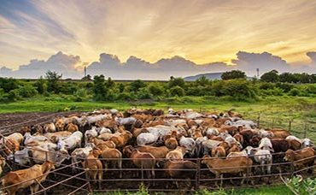
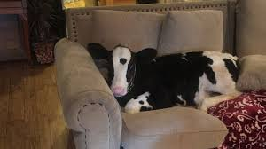
Pet vs Cattle
Pet have id=name
You take extra care of it
Cattle >= 1000 : anonymous
Id=Number, interchangeable

Slide 44
Launching => Scheduling on Allocated Resource
You submit
Something to run
You don’t run yourself
You don’t choose server
Then wait..
maybe allocate ++resources
(=> app retries managed)
You don’t have access to servers

Slide 45
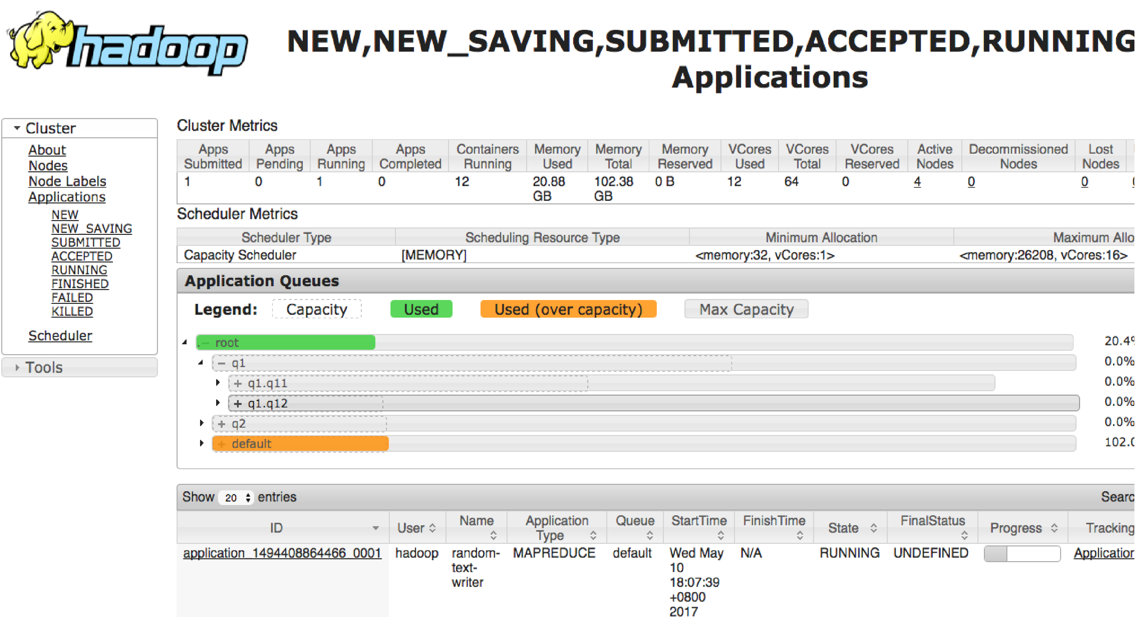
Yarn Queue
Queue Hierarchy :
Child queues => sum to 100%
Capacity / Max Capacity
… over-quota allowed
If Preemption enabled => may kill app in over-quota

Slide 46

Hadoop Yarn Architecture
Yarn “RM”
Node
Node
… Node
1
Protobuf API
Http Rest
Web Yarnui
ResourceManager
NodeManager
NodeManager
(2) launch
(4,5..)
launch
AppMaster
ResourceManager
(3) request
resources
Container1
Container2
Cont 3..
(1) Submit app
Relational DB
eg. postgresql
Submit Client App

Slide 47

Kubernetes Architecture
Etcd
Node
Node
… Node
1
kubelet
kubelet
(3,4..)
launch
Http Rest
Api Server
Operator
(2) request
resources
Container1
Container2
Cont 3..
(1) kubectl apply
kube Client

Slide 48

Architecture Comparison Yarn <-> Kubernetes
ResourceManager
API Server
Relational DB
eg. postgresql
Etcd
NodeManager
Kubelet
Container
(Jvm, Docker)
Container (Docker,..)
App Master
( 1 per App)
K8s Operator (1 per Type)
Yarn Quota
K8s Ns + Resource Request/Limit
Yarn Fifo Queue
Volcano / UniKorn (K8s extensions)

Slide 49
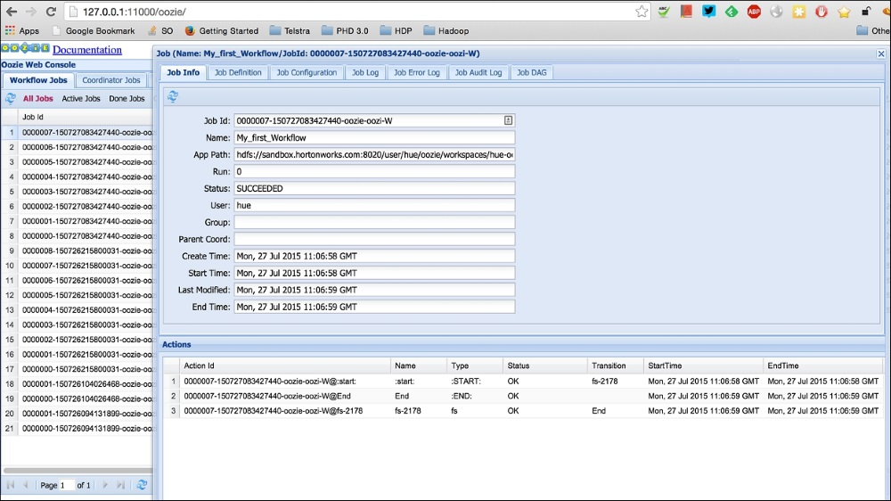
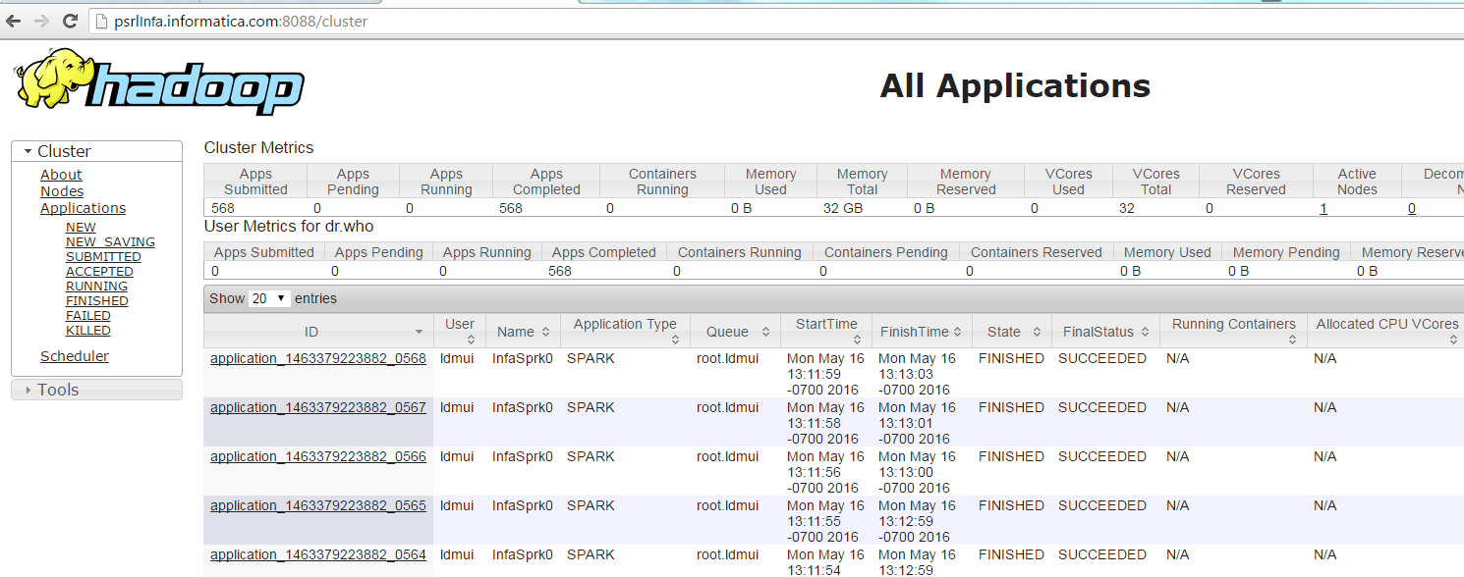
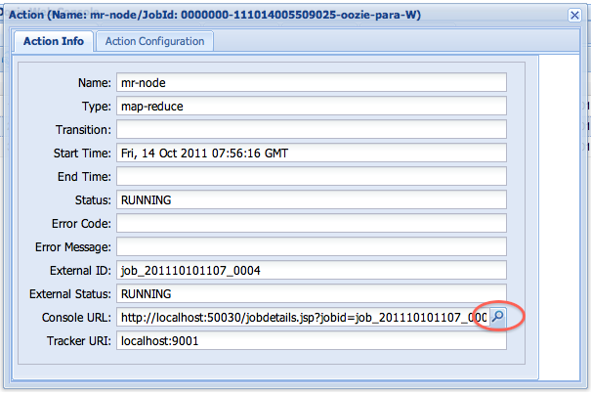
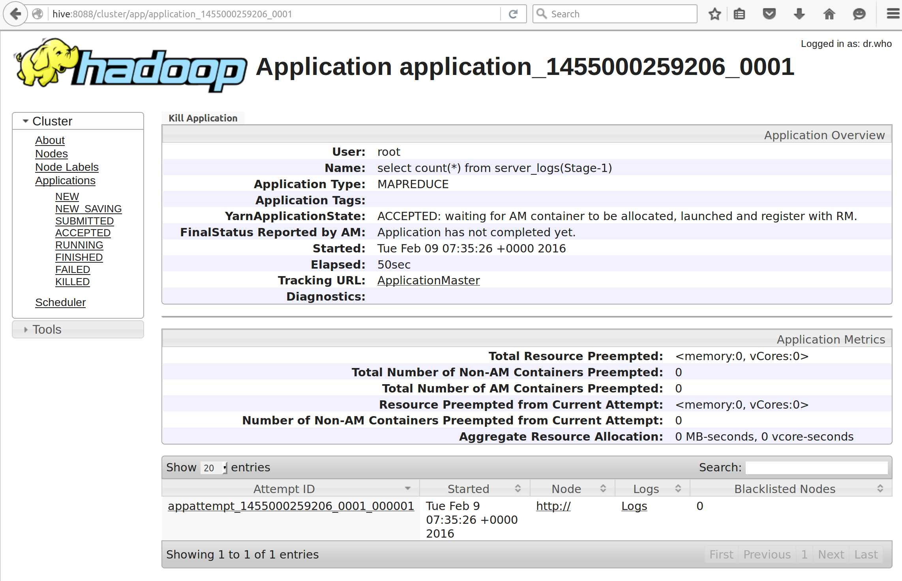
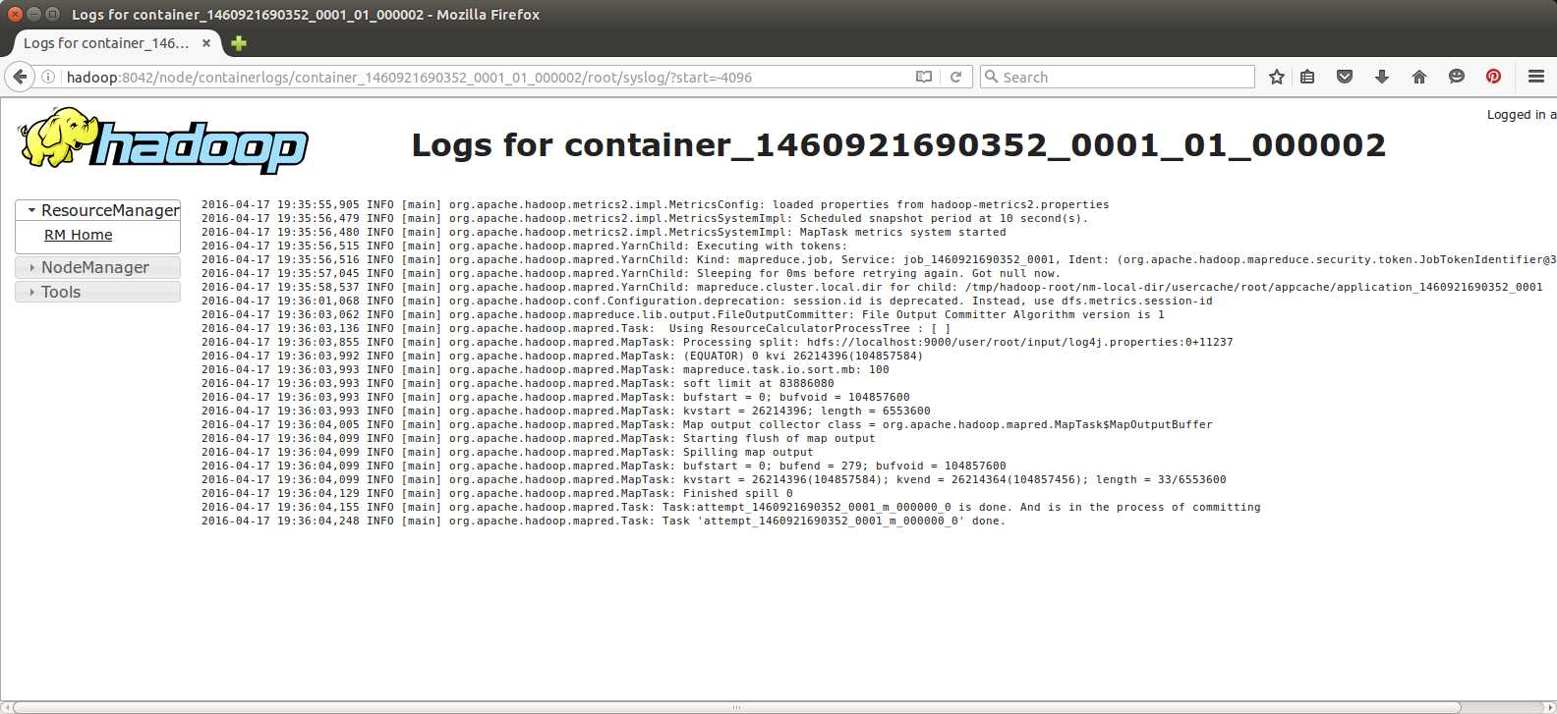
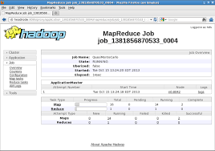
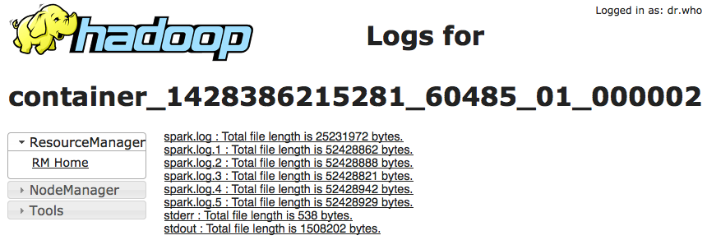
Ooozie → Yarn UI → Yarn … Nightmare, ex: Logs
1/ Find Oozie workflow Id
Example
Shell → spark-submit
7/ spark
6/ Yarn (spark-submit client)
5/ Mapreduce (SHELL) … call spark-submit --mode cluster
3/ Oozie shell action = “Mapper” of Map-Reduce in Yarn
2/ oozie-action
4/ Console URL = url in Yarn (Proxy or History)
11/ stdout !!
8/ appmaster application attempt 1
10/ log files page
9/ application (example: Reduce for shell)

Slide 50
Outline
What is BigData ?
Order of Magnitudes for « Big »
Distributed System challenges
Scaling Storage Resources: Hdfs
Scaling Compute Resources: Yarn, Kubernetes
Using Storage – Compute apis
Evolution of Hardware – Softwares – Hadoop Ecosystem, Spark
Description of a Datalake
Content
Usages
Example of Data-Processing
RAW to LAKE, Reports
Change Storage-Compute, Evolution to Cloud

Slide 51



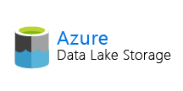

Recap .. Objective for Distributed Data Processing Solution:
Use Compute + Storage APIs
Job
Start/Stop/..
/Connect
API
IO Read+Write
API
Hidden physical
Resources
1 Virtual « Storage » Resource
= HDFS Hadoop Distributed File System
1 Virtual « Compute » Resource
= Yarn+Oozie (or Kubernetes) Distributed Container(Process/Pod) API

Slide 52
Recap .. Objective for Distributed Data Processing Solution:
Use Compute + Storage APIs
Job
Start/Stop/..
/Connect
API
IO Read+Write
API
Use API
For Compute Resources
Use API
For Storage Resources
Compute ONLY Resources
Storage ONLY Resources

Slide 53
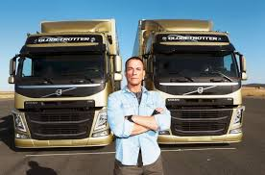
Data Processing = using Compute + Storage APIs
Compute
Cluster
>= 200 servers
Storage
>= 3 Peta bytes
Your Data Processing

Slide 54

https://www.youtube.com/watch?v=YVAVugfnW6Y

Slide 55





Spoiler Alert … Data Processing in Spark
Your Code:

Slide 56



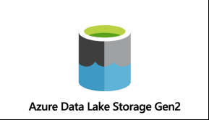



Spark Core Unified Engine… using Compute + Storage APIs
DataSource Connectors
(Hadoop API)
Cluster Manager
Core

Slide 57
Outline
What is BigData ?
Order of Magnitudes for « Big »
Distributed System challenges
Scaling Storage Resources: Hdfs
Scaling Compute Resources: Yarn, Kubernetes
Using Storage – Compute apis
Evolution of Hardware – Softwares – Hadoop Ecosystem, Spark
Description of a Datalake
Content
Usages
Example of Data-Processing
RAW to LAKE, Reports
Change Storage-Compute, Evolution to Cloud

Slide 58
Hardware Evolutions… => Architecture Changes
HDD = Hard Disk (magnetic + disks rotation) => slow « seek » to position
SSD => no more « seek » problem, so NO need to locally cache data in RAM
and huge read Go per second
Disk connectivity to motherboard => HDI < SCSI < SATA < …PCI Nvme …
Google « nvme vs sata ssd bandwidth »
SSD + NvMe => HUGE bandwith … > 4Go per seconds
( maybe more than network card support?)
Network cards … 10Go/s … fiber channel 100Go/s
So downloading HUGE file for Full scan is now OK !!
No more need to cache in local RAM, no need to collocate program near data

Slide 59
How Softwares evolve to handle BigData ? Which ones to use today?

Slide 60
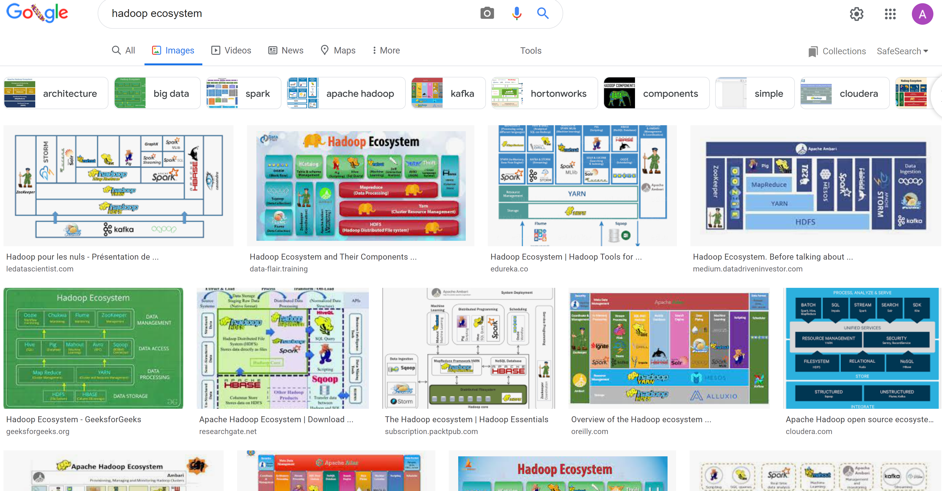
Hadoop Ecosystem « Explosion »

Slide 61



Spark (Recent) History & Ancestors
MapReduce @
2002 @Google
2004 Google
Paper published
2014 Google
No more used of MapReduce
2021 MapReduce bashing
… HDFS & Hadoop also
HortonWork bought by Cloudera HDInsight @Azure…very bad choice
.. To be abandonned
2006 @Yahoo
Hadoop implementation
2012 Yarn (v2)
2008 Apache Open-Source
1995 Message Passing Interface
??
2010 Spark paper
2013 Apache top-level
2015
Kubernetes
2020
Spark on K8s

Slide 62

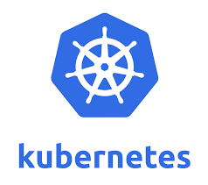


Datalake History At SG
~2 years ago (2020)
Decision to migrate to Azure
+ Dismantle On-Prem
Dec 2022
OFF
~8 years ago
2014
Init BigData cluster at SGCIB
2 major PROD projects:
- MiFid reports (all trades)
Var Risk
> 150 projects
~ 1 year ago (2021)
>= 100 projects migrate to Azure
Internal Re-organizations
Another Cluster..

Slide 63
Point in common
Despite all changes

Slide 64

MapReduce @Yahoo = Hadoop .. 2006
Commodity Hardwares (datacenters):
Only HDD + RAM
Data Locality : co-host Storage near Compute
use RAM to cache
avoid network
Constraint
=>
Architecture
Choice
Think different?
2006
2020

Slide 65

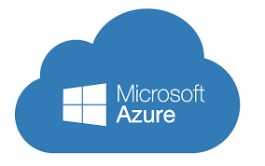
MapReduce -> Spark + other changes
Faster Disk (SSD)
Faster Network
Compute != Storage
Cloud
Constraint
=>
Architecture
Choice
Think different?
2006
2022

Slide 66


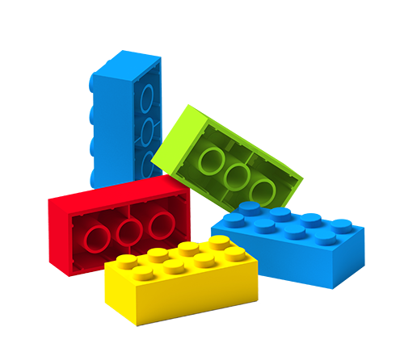
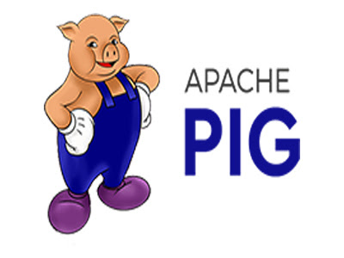











Simple => Many Specific Systems => Unified
“Unified” ecosystem
Simple
+ extensible modules
« Simple » ecosystem
( verbose inneficient & complex java code)
« Bazard » ecosystem
(Too MANY TOO redundant, complexes)

Slide 67

At The end, Only 1 will remain
( French TV Game: Koh-Lanta)

Slide 69
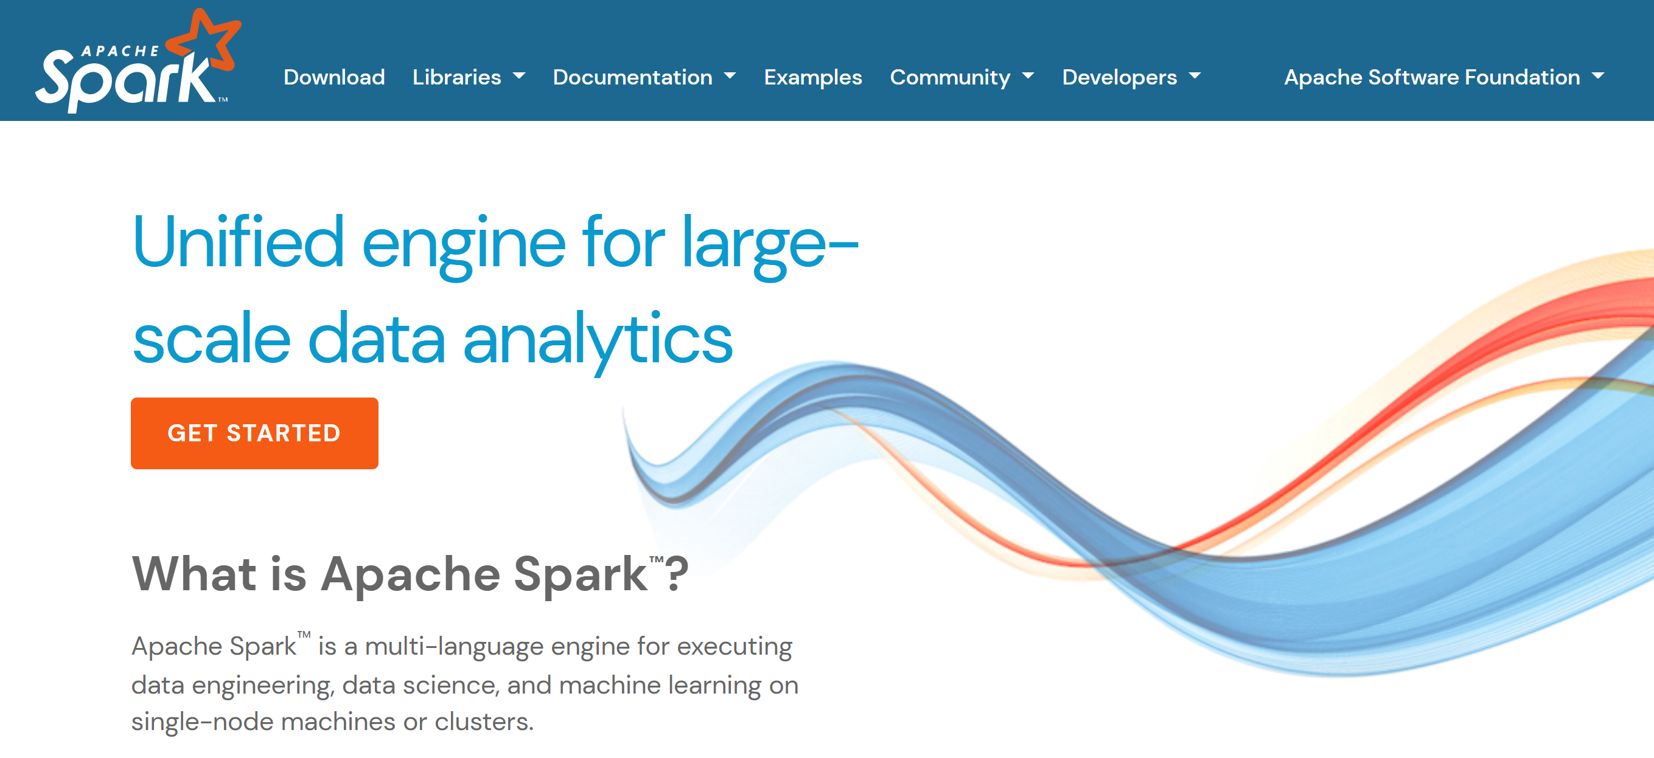
Spark = « Unified Engine »

Slide 70
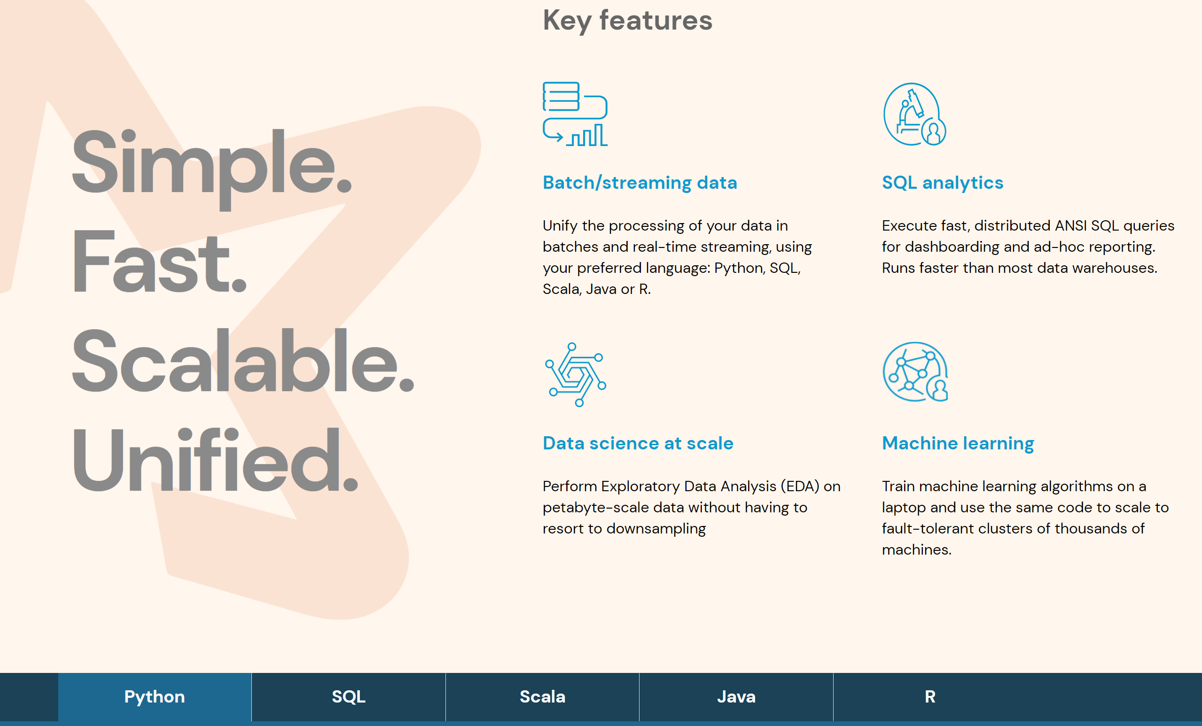
Multi Purposes – Multi Langages

Slide 71


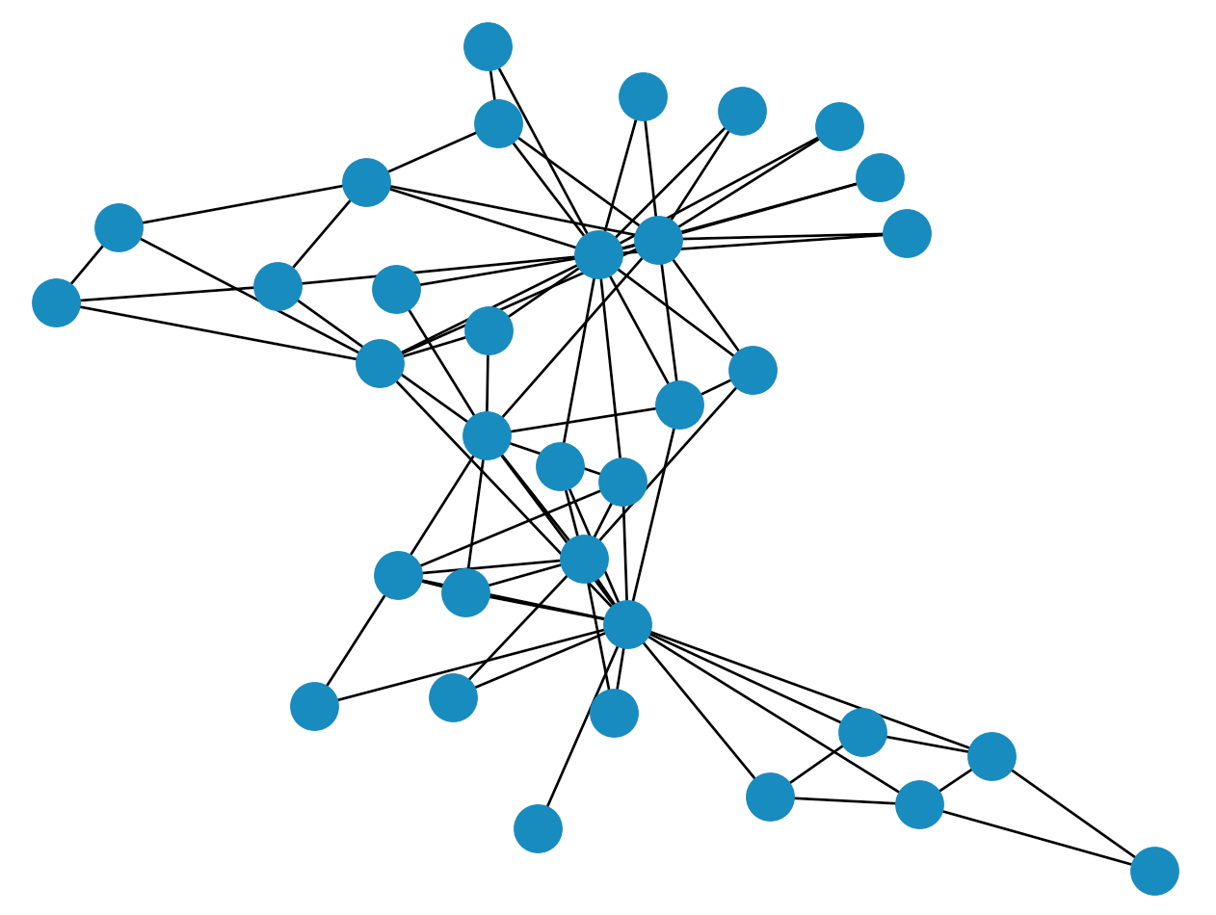



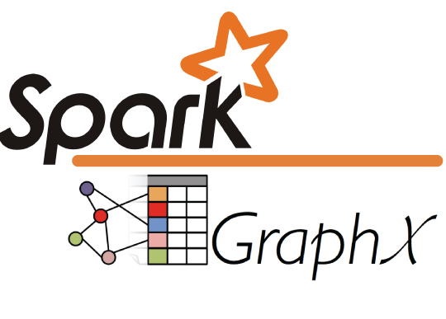


Spark-Core + …
Structured Data
Modules
DataSource Connectors
(Hadoop API)
Cluster Manager
Core
Langages Support

Slide 72
BigData = VVV …
Distributed Architectures (Horyzontal Scalling) => Challenges
Compute vs Storage Resources
Compute Api => Yarn, Kubernetes / Storage Api => Hdfs, Cloud
Hardware evolves, Hadoop Hdfs/Yarn is deprecated
Spark = Unified Engine, using both Compute Api and Storage Api
Take Away
Coffee Break

Slide 73
Outline
What is BigData ?
Order of Magnitudes for « Big »
Distributed System challenges
Scaling Storage Resources: Hdfs
Scaling Compute Resources: Yarn, Kubernetes
Using Storage – Compute apis
Evolution of Hardware – Softwares – Hadoop Ecosystem, Spark
Description of a Datalake
Content
usages
Example of Data-Processing
RAW to LAKE, Reports
Change Storage-Compute, Evolution to Cloud

Slide 74
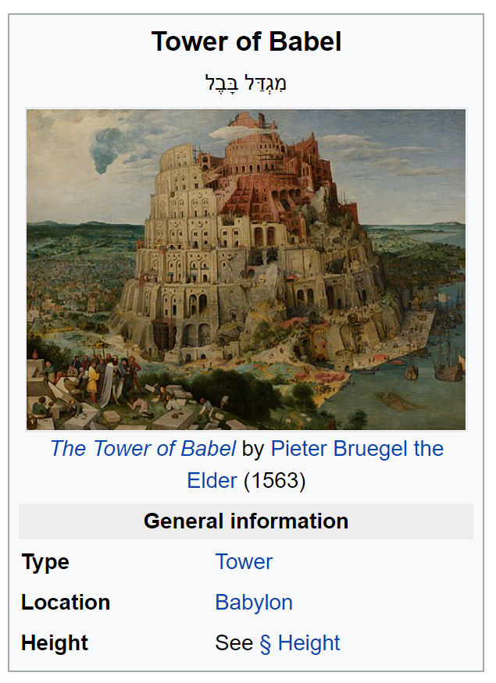
Not Only Machines
~ 200 different Teams / 10 departments
… for 1000 developpers / data engineers / users
In Paris.. But not Only (Bangalore, Montreal, London, New-York, ..)
On ~6000 tables,
described in 1500 DataSets
Lot of Financial / Functional aspects

Slide 75
Feeding Data Inputs to Datalake: aggregating >= 150 Systems
System1:
Referential Data
System2:
Equity Trade
System3:
FixeIncome Trade
System4:
Credit Trade
System N:
MarketData
Computing Var/Risk

Slide 76
Feeding Data / Streaming
BigData at SG is mostly « uploading daily files »
then launching « daily batches »
Many Trade extractions are Real-Time Streaming
… but aggregated in Files per Hours / per Day
Var Computing during night … Huge streaming of events
from dedicated pricing cluster (GPUs)

Slide 77
Feeding Types & Volumetry
Daily batches: upload Files
Teras/day
( millions of files)
Streaming then converted to Files
Streaming to Key-Values Databases
Billions events/day
Peeks to 4000 events/seconds
on each 100 x servers
During 4hours nightly Var batches

Slide 78



Content of a Datalake
FileSystem
= Directories + Files
For batches
Key-Value database
FAST get/put access by single key
Hive Metastore = SQL View
« Table » abstraction for HDFS / Hbase

Slide 79
Storage = Files and Directories
How would you organize
1 Billions Files
in 50 Millions Directories ?
How do you ensure data respect directories organization ?
Try Scanning Directories ?

Slide 80
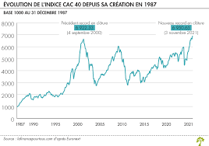
A Very « Simple » Specific Sub-System
« Tick » per seconds
From Market Exchange Places
(Bourse Paris, London Stock Exchange, …)
1 binary file per Day/Place/Instrument
… 2M files per day
… 40 Giga per day
… since 22 years … 25 Billions Files / Petas
Volume, Velocity … but not Variety
( NO spark, No Hadoop )

Slide 81
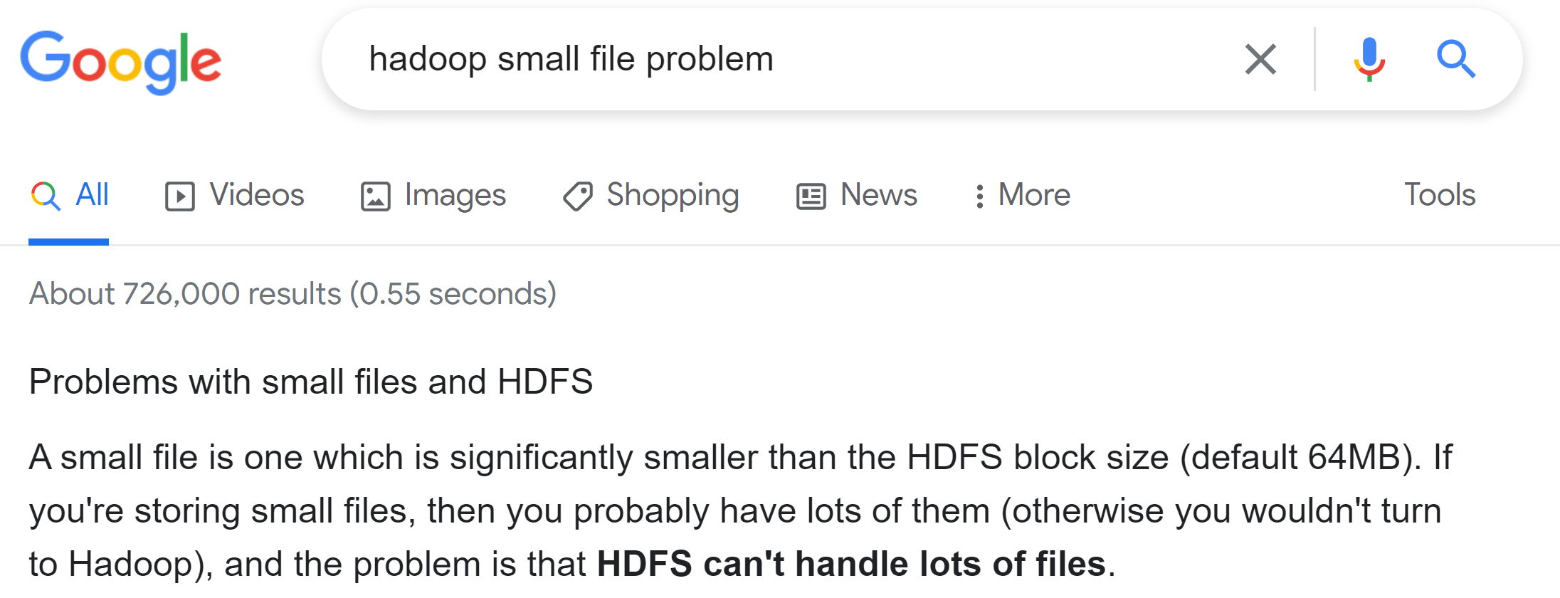
Hadoop hates too many Small Files

Slide 82
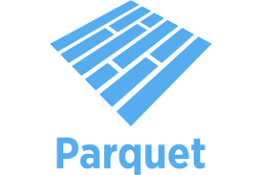
BIG Files ? More than Giga ? YES … BUT PARQUET Partitioned
Doing BigData = using PARQUETFiles (correctly with )
End Of Story.

Slide 83
Outline
What is BigData ?
Order of Magnitudes for « Big »
Distributed System challenges
Scaling Storage Resources: Hdfs
Scaling Compute Resources: Yarn, Kubernetes
Using Storage – Compute apis
Evolution of Hardware – Softwares – Hadoop Ecosystem, Spark
Description of a Datalake
Content
Usages
Example of Data-Processing
RAW to LAKE, Reports
Evolution to Cloud

Slide 84
Governance Data Directories Organization Read-Write Permissions, Quota, RDPG …
How would you organize Read-Write Permissions on 6000 tables x 1000 jobs ?
/ <root HDFS>
/env
/ {raw|lake}
/dir =by Team
/subDir =by domain /sub-subDir=Hive table
/hive partitions /*.parquet
Project ask access
AND describe « Datasets » ( data owner)
=> Validation by DataOffice
=> Create domain sub-dirs + granted recursive WRITE permission
Project ask for a « Usage » Job
Explain Inputs/Output => Validation by DataOffice
=> Grant recursive READ permission for inputs

Slide 85
LAKE = Parquet Starting from RAW: Postgresql or {CSV|Json|Avro..} STAGING Dirs
private RAW Layer
sharable LAKE Layer
Upload data
Transform RAW 2 LAKE
PARQUET Files
Postgresql Extract
FTP/Hdfs Files upload
In CSV,Text,Json,Xml,…
Streaming flushed
as Avro Files (Flume)
private APP Layer
Any File format
Example for export to OLAP

Slide 86
Feeding – Transforming – Consuming Data
Project 1
( Feeder only)
Every project is granted 3 Read-Write Databases: RAW, APP, LAKE
LAKE are sharable … designed to be efficiently RE-read after (for analytical)
Every project can request Read access on others LAKE
( after validation by Data-Office )
A Dataset is writable by only 1 Project (the owner )
Project 2
( Feed + Enrich)
Project 3
Project 4
( Transform only)
Project 5
( consume
Only, for reports )

Slide 87
Big Processing
>= 1000 periodic jobs running daily / or every hours
Some processing take >= 15 Hours
Some processing are distributed on more than 200 yarn containers
Some take more than 1000 Go of RAM

Slide 88
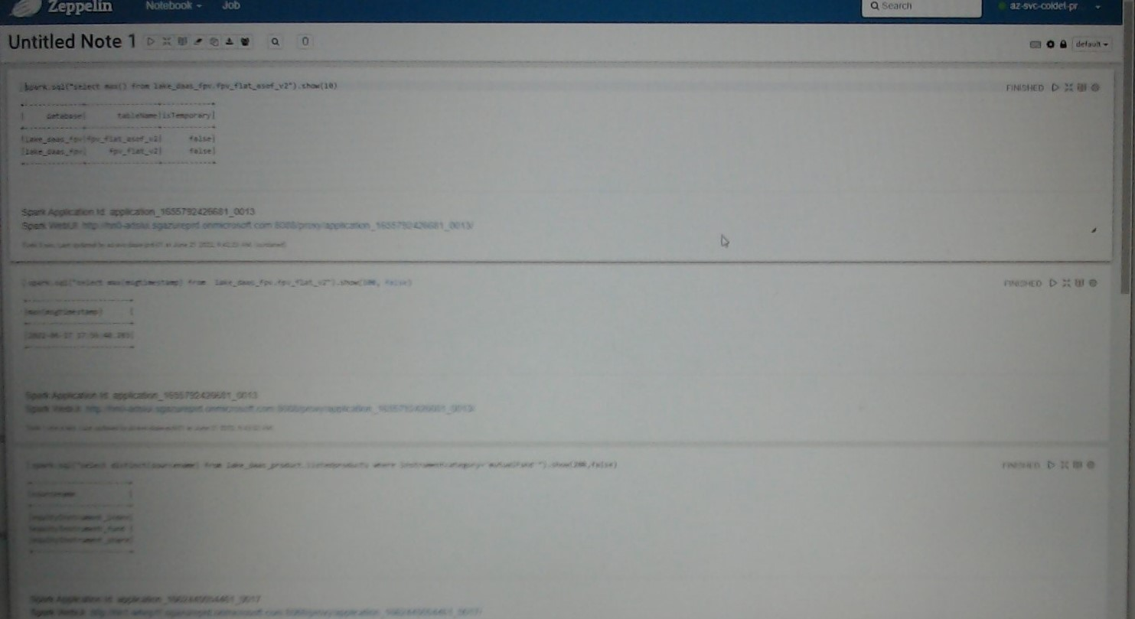
Few Interactive Queries Processing screenshot Zeppelin

Slide 89
Orchestration / DataLineage Data and Workflows are linked

Slide 90
Read-Write Permissions from DataOffice
Dataset « Feeding » declaration:
= exclusive Write Permission : Project -> canWrite -> DB
For validation by DataOffice, DataSet must be described :
confidentiality, source, business owner, quality, RDPG legal
Consumer declaration:
= authorization to read : Project -> canRead -> DB
… for a specific Usage
For validation by DataOffice, use-case must be described,
usage must be « legitimate » , RDI legal

Slide 91
DataLineage Data depends on other Sources Data

Slide 92
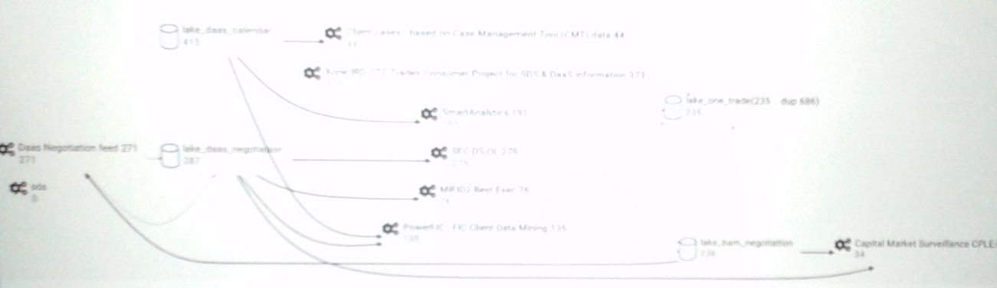
Screenshots (Fuzzy.. On purpose) Read/Write Dependencies Hive Database / Job…
Zooming on 4 out of 250 Hive databases

Slide 93
Orchestration Start process2 after process1 finished
Start condition= CRON 1 * * * * * *
Start condition= Wait for data…
Start condition= CRON 10 * * * * * *

Slide 94


Prod Screenshot (Fuzzy.. on purpose) Running Yarn Applications
MAPREDUCE ?
… only internally to launch shell commands.. To spark
ALL others = SPARK

Slide 95

Prod Screenshot : Yarn Queues (Scheduler, CPU+Mem usages)
You see scrollbar?...
Hundreds or Yarn Queues
+ dozen of sub-queues

Slide 96

Screenshot Oozie (Coordinators / Workflows)
You see pagination?...
Thousands of CRON jobs
Oozie display only last 50 000 workflows
… so only 2 days of history

Slide 97


Orchestration « By CRON: 10 * * * * * » Example of Possible Failures
batch1 started at 1 *** … but takes today (anormally) 15h instead of 10h
expected
actual
batch2 started at 12 *** …. data not yet present
=> NO « today » data (only yesterday)
Finished FAST, with NO data
batch2 started, during critical section of batch1 … table dropped/recreated after

Slide 98
Outline
What is BigData ?
Order of Magnitudes for « Big »
Distributed System challenges
Scaling Storage Resources: Hdfs
Scaling Compute Resources: Yarn, Kubernetes
Using Storage – Compute apis
Evolution of Hardware – Softwares – Hadoop Ecosystem, Spark
Description of a Datalake
Content
Usage
Example of Data-Processing
RAW to LAKE, Reports
Evolution to Cloud

Slide 99
Typical Example of adding 1 daily partition
$ hdfs dfs –mkdir hdfs://raw/team/domain/table/date=2022-10-12
$ hdfs dfs –put localFile hdfs://raw/team/domain/table/date=2022-10-12/
$ spark-sql –master local[1] \
–e « ALTER TABLE raw_lake_domain.table ADD PARTITION ( date=‘2022-10-12’ ) »

Slide 100
Typical RAW to LAKE processing with Spark as Java code
spark.read .format(« csv ») .option(«schema », « col1 type1, … colN typeN ») .load(« hdfs://raw/team/domain/table/date=2022-10-12 ») .map(row -> transformData(row) ) .repartition(3, « col1 ») .sortWithinPartition(« col1, col2, col3 »)
.write .format(« parquet ») .save(« hdfs://lake/team/domain/table/date=2022-10-22 »)
;
read
transform
write

Slide 101
Typical RAW to LAKE processing with Spark as SQL code
write
INSERT OVERWRITE
lake_team_domain.table SELECT /* +REPARTITION(col1, 3) */
col1, col2,
udf_func1(col3, col4) as col3,
udf_func2(col4, col5) as col4,
..
FROM
raw_team_domain.table
JOIN
lake_anotherTeam_domain.anotherTable x ON x.ID=id
WHERE date=‘2022-10-22’ AND ..
SORT BY col1, col2, col3 -- idem sortWithinPartition
transform
read
transform
read
write

Slide 102
Example of LAKE Aggregation
INSERT OVERWRITE
lake_team_domain.table SELECT * FROM (
SELECT * FROM table1 WHERE ..
UNION
SELECT * FROM table2 WHERE ..
UNION
SELECT * FROM table3 WHERE ..
UNION
SELECT * FROM table4 WHERE ..
)
SORT BY col1, col2, col3 -- idem sortWithinPartition

Slide 103
Example of « latest value » cristalisation analytical query « over(partition by) »
INSERT OVERWRITE
lake_team_domain.table SELECT
col1,col2,…. colN -- idem * EXCEPT rank (cf issue SPARK-33164)
FROM (
SELECT *,
RANK() OVER (PARTITION BY id ORDER BY update_time DESC) as rank
FROM lake_team_domain.event_table
)
WHERE rank=1
SORT BY col1, col2, col3 -- idem sortWithinPartition

Slide 104

Example of a « Small » Data Processing resource needed = RAM
Basic Compute
SQL
Select .. where ..
Save Result
Export to OLAP Cube
Enrich « JOIN »
With other tables
Extract all the Trades on perimeter « X »
Since <= 3 Years
Processing on Azure
using cluster 10 x D14 (100 000 euros/year)
ONLY 600 Giga of RAM data …
NOT Enough => Swapping => take 4 Hours

Slide 105
Example of a Slow « Un-parallelized » Processing resource needed = CPU x Time x ..
For each XML, extract
xpath(« a/b/c/d/e ») as column1,
xpath(« a/b/f/g/h ») as column2,
…. as column150,
<XML>
Append to History
(Audit Events)
Appending every day
~1 Avro file, containing
~50 Millions of <XML>..</XML>
~70 Mega bytes
(updates on EquityOption trade description)
Synthesised Latest View

Slide 106
A Slow Processing ?
Legacy « On-Prem »
Daily Batch takes >= 15 Hours
But is mostly SINGLE-THREADED !!!
Some Parallelized intermediate parts take
>= 200 yarn containers … 10% of Cluster
… Result = ULTRA FAST !!
Backported code « as-is » to Azure HDInsight
Used Cluster of 10 x D14 cluster (40 000 euros/month)
Run NEVER Finished
… stopped in « echo count lines before insert $(… ) »
Fully re-implemented in Spark + Java
instead of Hive SQL + UDF xpath
+ Optimized …
Now run in 40 minutes on 2 x D13 cluster

Slide 107
At SG, most workflows are uploading daily files + processing by daily batches
Except 1 Huge stream feeding
Almost all use Spark
Take Away
Interactive queries
Batch mode
Streaming mode
Spark Supports
Coffee Break

Slide 108
Outline
What is BigData ?
Order of Magnitudes for « Big »
Distributed System challenges
Scaling Storage Resources: Hdfs
Scaling Compute Resources: Yarn, Kubernetes
Using Storage – Compute apis
Evolution of Hardware – Softwares – Hadoop Ecosystem, Spark
Description of a Datalake
Content
Usages
Example of Data-Processing
RAW to LAKE, Reports

Slide 109
… More Detailed on « From OnPrem to Azure Cloud » see Document « -cloud.pdf »
Appendix:
Cloud

Slide 110





Fundamental Resources TradeOffs
Appendix:
Cloud
Network (Bandwith, Latency)
Development price / Run cost
€€€€€€$$$$$
Horyzontal Scale
CPU (HOT, Watts)
Cold Storage
(SLOW)
Storage (~Small)
RAM (FAST .. Expensive)

Slide 111

Performance Changes -> Architecture Changes
Appendix:
Cloud
Storage and Compute can be SPLIT … OK !
Higher Density for Huge Storage, lower prices
Historically:
SLOW Disks
Disk Collocated with RAM+CPU
MapReduce « send program » collocated to data
Now:
FAST(ER) SSD Disks + Networks
Can « send» data to distributed programs
48 * disks in 2U blade
1 Peta SSD … 200 000 €
Cloud Provider : AWS, Azure, Google offer Storage solutions (S3, Azure Storage, ..)
+ Managed Services
+ Serverless
+ Kubernetes

Slide 112
Migration to Cloud Azure - AWS - Google
Appendix:
Cloud
Goals:
Elasticity of Storage (No more fear of HDFS FileSystem Full)
Elasticity of Compute (adapt CPU to workload… Pay only what you use)
Clear visibility of cost per Projects / internal refacturation
By-Pass internal IT department
Easier (?) Self-Service API for Provisionning
No More Multi-tenant (no risk of 1 project crashing/consuming whole cluster)
Since 2020 SGCIB is moving its Datalake to Azure

Slide 113
Architecture of Datalake on Clouds
Appendix:
Cloud
Azure Cloud
Azure Tenant
Intranet LAN
Firewall - Restrictions – BluePrint Rules - ..
HUB Network
/ Socks Proxy
Azure Subscription
(per project)
RAW Storage Account
Dedicated ExpressRoute
VM, AKS, HDI ..
VM, AKS, HDI ..
LAKE Storage Account
VM, AKS, HDI ..
VM, AKS, HDI ..

Slide 114

BigData Engineering from OnPrem to Azure
Appendix:
Cloud
Development of custom Yarn/Oozie/Ranger tools
1 Huge cluster, used as Multi-tenant (several users)
Used at 100%
Almost Disk-Full
Many report on disk usage / data purges
Clear view of all Running workloads
(1 Ambari screen)
Lot of Network & Security
Development of Provisionning « sudo » tools
NO more multi-tenant system… but LOT of small clusters
Hundred of clusters, each used at 5% !!!
COST COST COST
Necessity to Optimize Performance
( batches too long… 100x slower / too expensive)
No more Disk worry
… data is growing (no more purges?)
NO admin central view
NO Orchestration of workloads

Slide 115



What About Spark in Azure Migration?
Appendix:
Cloud
COST COST COST
Necessity to Optimize Performance
( batches too long… 100x slower / too expensive)
=> Many projects have
migrated + optimized
+ UDF
+
Optimized Spark Reduced memory + Cluster sizes

Slide 116



Managed Spark ? Goals: Autoscaling / « serverless »
Appendix:
Cloud
Managed by Azure :
Managed via Kubernetes
databricks
AWS : EMR
GCP : BigQuery

Slide 117
Questions?

Slide 118
Take Away
What is BigData ? Horyzontal Scaling
compute: cluster with Tera of RAM used by Spark apps
storage: Petas of Files, in parquet
What is Spark ?
Simple unified Sql/Java engine
for distributed compute (Yarn/Kubernetes)
distributed storage (HDFS/cloud)
What is Processing ?
mostly spark batches
Feeding RAW
Transforming RAW to LAKE
Consuming SQL analytics
Hadoop ecosystem is complex, Spark brings simplicity
Ecosystem is evolving (Cloud, Kubernetes)

